Slide 1

INTEGRATED MARKETING COMMUNICATIONS:
Ward Klein

Slide 2
Brand Description & Positioning
The Ford Motor Company is a historical automotive corporation tasked with constructing and providing efficient modes of transportation.
The brand’s mission statement is “To drive human progress through freedom of movement”
The company’s brand positioning statement promotes the foundation as a viable option toward a fuel-efficient choice for automobile buyers through the “Go Further” tag line.
Company. (n.d.). Retrieved April 5, 2020, from https://corporate.ford.com/company.html

Slide 3

Advertising
The one way communication channel operates via television broadcasts, radio, billboards, and online messages that altogether promote an accumulated, informative message to automobile buyers.
Local communities’ dealerships can afford their own advertisements to reach out to residents within the establishment’s jurisdiction to maintain quality and further improve relationships with the company itself.
Corporate Ads like the recent “Built Ford Proud” and “Built Ford Tough” initiated the business’ ambition to further acquire and apply future innovations to satisfy drivers.
The objective is to continuously update existing and potential consumers about the latest developments in the company’s product lines.
Notes:
The primary channel that seems to have attracted and spread the company’s brand awareness is conducted through advertising campaigns.

Slide 4
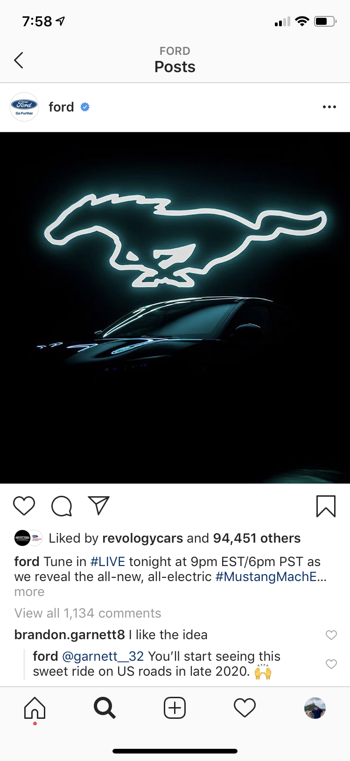
Social Media
The company’s Facebook page grants access to featured sneak peaks in addition to video interviews with the design team and chief engineer regarding current projects.
The two-way communication channel allows officials to interact with consumers by spotlighting their testimonies, experiences, and reward programs based on demonstrated interests.
For instance, Ford recruited 100 people to drive the Ford Fiesta up to six months while paying for their gas and car insurance through an initiated program entitled the “Fiesta Movement” in 2009. As a result, the module generated 6.2 million views on YouTube in conjunction with 750,000 views via Flickr and 40 million Twitter impressions.
The channel’s primary objective is to establish an inclusive community among mutual owners, non-owners, and young prestigious individuals where all of them can gain further insight into the foundation’s ideal developments.
Fell, J. (2013, February 19). 3 Social Media Lessons from Ford. Retrieved April 5, 2020, from https://www.entrepreneur.com/article/225861

Slide 5
Public Relations
The process involves a one-way communication to relay necessary information relevant to product lines, franchises, and divisional programs.
Ford Field, home of the Detroit Lions, projects a sponsored brand association with fans, owners, and local communities alike due to its naming rights. Through this foundation, the company can establish a presence among publicly sanctioned events.
The company can also lead a campaign by emphasizing events, announcements, partnerships, and model reveals that easily appeal to a target audience of motorsport enthusiasts. For instance…
  Steve McQueen’s 1968’ GT350 Bullitt mustang was remodified and unveiled to commemorate the 50th anniversary of iconic car at the 2018 Detroit Auto Show.
  The company’s long-term partnership with Shelby American Inc. maintains an output of mustangs and raptor trucks.
  Recruiting the best online gamers across Europe to compete for the company’s first virtual eSports racing team.
  The recent motion picture release of “Ford v. Ferrari” entertains and educates millennial audiences, who have grown adapted to sustainable engineering at this point, the company’s roots in motorsports.
The channel’s objective is to promote a conceptualized image of speed and style in association with the motorsport segment as a way to adapt the millennial generation.
N/A. (2019, August 9). FORD GETS SERIOUS ABOUT GAMING, LAUNCHES MOTOR RACING TEAMS TO COMPETE IN INCREASINGLY POPULAR WORLD OF ESPORTS. Retrieved from https://media.ford.com/content/fordmedia/feu/it/it/news/2019/08/19/Gamescom2019.html
DeBord, M. (2018, January 14). Ford just unveiled a Mustang that references a legendary movie car chase starring Steve McQueen. Retrieved April 5, 2020, from https://www.businessinsider.com/ford-mustang-bullitt-mustang-detroit-auto-show-2018-2018-1

Slide 6
Direct Selling
The channel projects a two way communication grid between prospective consumers, corporate partners, and the company’s appointed field agents to help interconnect the quality of Ford vehicles with their needs.
Dealerships bring the experience to the consumer who would like to test drive a certain model that benefits their needs and desires in innovative travelling.
The Ford Performance School of Racing in Charlotte offers valuable training to both current owners and non-owners who may like to inherent as much as master the abilities to handle Mustang formatted racing cars.
  In 2016, it was reported that 200,000 performance cars were sold as a direct result.
Ford's practical approach of showrooming recent released models whether in malls or sanctioned events gains exposure in personal selling as well.
Ford Performance Car Sales to Surpass 200,000 in 2016. (2016, September 26). Retrieved April 5, 2020, from https://performance.ford.com/enthusiasts/media-room/2016/09/thrill-seeking-drivers-around-the-world-turning-to-ford-in-recor.html

Slide 7
Evaluation of Brand’s IMC
The channels integrated can easily relay an equal-leveled, universal message emphasizing performance, family, satisfaction, efficiency, and speed altogether.
The channels’ highlighted qualities more likely strengthen and adjust the brand’s positioning toward a diverse-innovative technological angle.
They convey a central point of view where the Ford Motor Company can evolve beyond the traditional assembly line to include formulated personal relationships with newly inducted product lines and guaranteed sustainable output.
The Public relations aspect seems out of line with the majority of communication channels due to its focus on ideal beneficial contributions rather than customer oriented approaches.

